Slide 1
W4111 – Introduction to Databases Section 002, Spring 2025 Lecture 7: ER(6), Relational(6), SQL(6)
© Donald F. Ferguson, 2025

Slide 2

Today’s Contents
2 | COMS W4111_002_2025_1 - Lecture 7: ER(6), Relational(6), SQL(6) © Donald F. Ferguson, 2025

Slide 3
Contents
Introduction and course updates.
Finishing relational algebra. Relational algebra will be on midterm and final.
Last topic SQL, specifically transactions. SQL will be part of future homework assignments, midterm and final.
Normalization – initial overview.
A first look at NoSQL.
Databases and applications
Web applications
Data engineering

Slide 4
Introduction and Course Updates
4 | COMS W4111_002_2025_1 - Lecture 7: ER(6), Relational(6), SQL(6) © Donald F. Ferguson, 2025

Slide 5
Course Updates
Project data set:
I recommend that both tracks use the IMDB and Game-of-Thrones dataset that I use in my examples.
But, you may choose your own dataset. I will publish requirements on your dataset tonight or tomorrow. You will describe your dataset in HW3B submission.
HW3B:
Very simple. Basically, extend my examples and execute.
You will have to do some new DB concepts, e.g. create views.
Midterm:
In class, 14-MAR from 10:20 to 11:40. Please arrive by 10:10.
I will cancel the 2nd half of the lecture. You may be tired and need a break from DBs.
On-line and timed (90 minutes) using Proctorio.
Released 14-MAR in the morning and due by 5pm.
No one showed up for the preparatory recitation.
3B due after break.

Slide 6
Relational Algebra
6 | COMS W4111_002_2025_1 - Lecture 7: ER(6), Relational(6), SQL(6) © Donald F. Ferguson, 2025

Slide 7
Relational Algebra
A procedural language consisting of a set of operations that take one or two relations as input and produce a new relation as their result.
Six basic operators
select: σ
project: ∏
union: ∪
set difference: –
Cartesian product: x
rename: ρ

Slide 8
What are all those other Symbols?
Some of the operators are useful and “common,” but not always considered part of the core algebra.
Some of these are pretty obscure
Division
Anti-Join
Left semi-join
Right semi-join
Most SQL engines do not support them.
You can implement them using combinations of JOIN, SELECT, WHERE, ... ...
But, I cannot every remember using them in applications I have developed.
Outer JOIN is very useful, but less common. We will cover.
There are also some “patterns” or “terms”
Equijoin
Non-equi join
Natural join
Theta join
... ...
I may ask you to define these terms on some exams or the obscure operatorsbecause they may be common internships/job interview questions.
Τ. order by
γ group by
¬ negation
÷ set division
⨝ natural join, theta-join
⟕ left outer join
⟖ right outer join
⟗ full outer join
⋉ left semi join
⋊ right semi join
▷ anti-join

Slide 9
JOIN
Natural Join: section ⨝ classroom
Equivalent to
π course_id, sec_id, semester, year,
section.building, section.room_number, time_slot_id
(section
⨝ classroom.building=section.building
∧
classroom.room_number=section.room_number
classroom)
Equivalent to
σ section.building=classroom.building ∧
section.room_number=classroom.room_number
(section ⨯ classroom)
You can derive ⨝ from σ, π, ⨯
There are naming conventions for types of JOIN
Natural JOIN
Equi-JOIN
Theta JOIN

Slide 10
LEFT, RIGHT, OUTER JOIN
-- The calculator does not like me to assign null to values.
-- So, I used 0, which violates Codd's Rules.
-- What are the R rows not in the join with NULL for T columns
--
one = π a,b,c,d←0 (R - (π a,b,c (R ⨝ T)))
-- What is "in" the join
two = R ⨝ T
-- Left out join is the union of the two.
one ∪ two
You can derive
⟖ from π, -, ∪, ⨝
⟖, ⟗, ∪

Slide 11
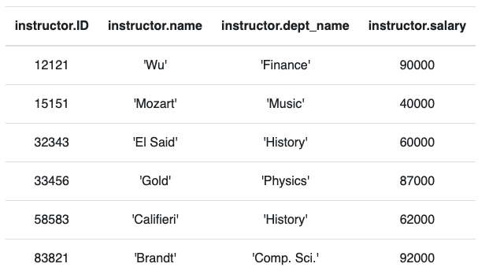
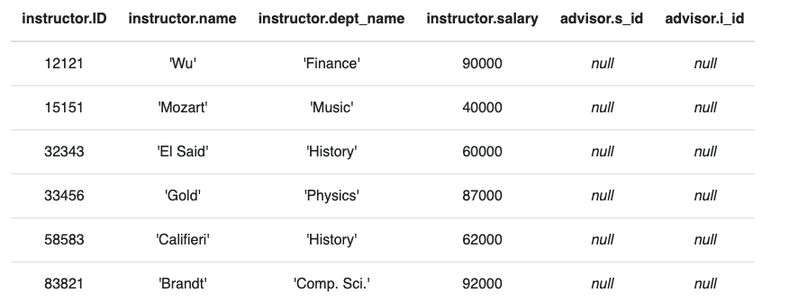
Anti – Join
“An anti-join is when you would like to keep all of the records in the original table except those records that match the other table.”
instructor ▷ ID=i_id advisor
σ i_id=null (instructor ⟕ ID=i_id advisor)

Slide 12
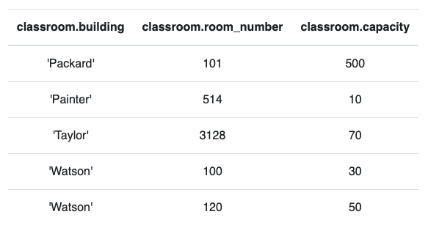
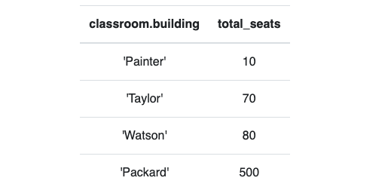
Group By, Order By
classroom
These are very simple examples.
We can apply them to relations created by operations on other tables.
τ total_seats (γ building; sum(capacity)→total_seats (classroom))

Slide 13
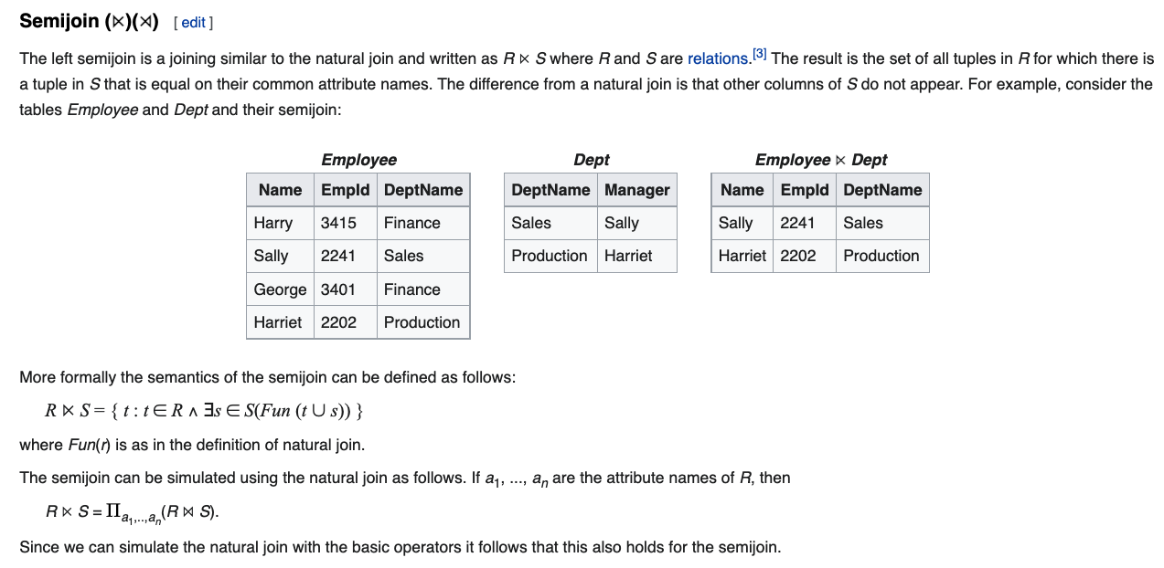
Semi-Join

Slide 14
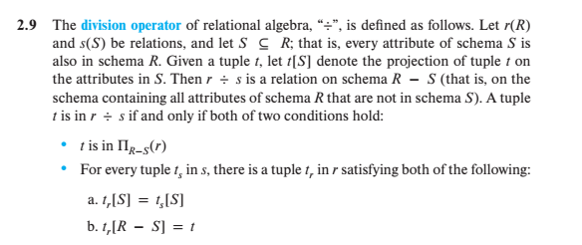
Division
Well, that is crystal clear.
My head hurts every time I must remember this for that one slide every semester. But, this makes a cool exam question!

Slide 15
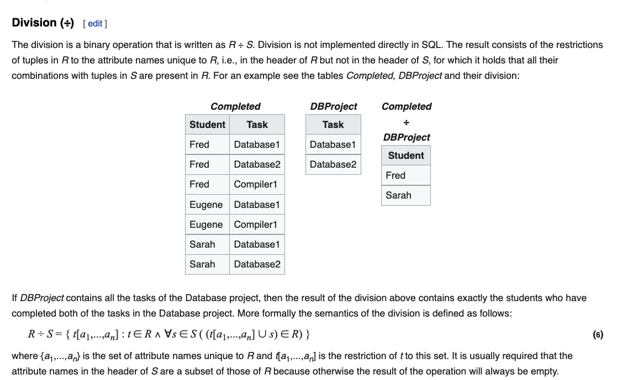
Division

Slide 16
Relation Algebra Summary
There is a core set of “standard” operators in the algebra.
Since it is an “algebra” and closed under operator composition, it is possible to “define” some additional operators that are “useful” by combining more basic operators into expressions.
If I ask relational algebra questions on homework assignments, you can always look up the operation.
For exams,
You are responsible for understanding π, σ, ←, ∪, ∩, -, ⨯, ⨝, theta- ⨝, ⟕, ⟖.
If I ask about other operators, I will give the definition.
I like to ask questions about how to derive operators from more basic operators.
We are done with relational algebra in lectures. “Mic Drop.”

Slide 17
SQL
17 | COMS W4111_002_2025_1 - Lecture 7: ER(6), Relational(6), SQL(6) © Donald F. Ferguson, 2025

Slide 18
Using Transactions We will cover in more detail in Module II.
Introduction
18 | COMS W4111_002_2025_1 - Lecture 7: ER(6), Relational(6), SQL(6) © Donald F. Ferguson, 2025

Slide 19
SQL Parts
DML -- provides the ability to query information from the database and to insert tuples into, delete tuples from, and modify tuples in the database.
integrity – the DDL includes commands for specifying integrity constraints.
View definition -- The DDL includes commands for defining views.
Transaction control –includes commands for specifying the beginning and ending of transactions.
Embedded SQL and dynamic SQL -- define how SQL statements can be embedded within general-purpose programming languages.
Authorization – includes commands for specifying access rights to relations and views.

Slide 20
Transaction Concerns (I)
There are 3 different programs in three different memory spaces.
Alice
Bob
The DBMS
If A is initially $100
Alice reads $100
Bob reads $100
Alice write $50
Bob writes $50
The final value of A in the DBMS is $50, but “the ATM” issued $100.
Alice | Bob
Read(A)
 | Read(A)
A = A-50
 | A = A-50
Write(A)
 | Write(A)

Slide 21
Transaction Concerns (II)
There are 2 different programs in two different memory spaces.
Alice
The DBMS
Programs and computers fail.
If something fails
After Write(A)
Before Write(B)
The bank “lost” $50
Alice
Read(A)
A = A-50
Write(A)
Read(B)
B = B+50
Write(B)

Slide 22
Transaction Concept
A transaction is a unit of program execution that accesses and possibly updates various data items.
E.g., transaction to transfer $50 from account A to account B:
BEGIN TRANSACTION {
1. read(A)
2. A := A – 50
write(A)
4. read(B)
5. B := B + 50
write(B)
COMMIT or ROLLBACK }
Two main issues to deal with:
Failures of various kinds, such as hardware failures and system crashes
Concurrent execution of multiple transactions
BEGIN TRANSACTION {
1. read(A)
2. A := A – 50
write(A)
4. read(B)
5. B := B + 50
write(B)
COMMIT or ROLLBACK }
Transfer(to_a, from_b, amount)

Slide 23
Transactions
A transaction consists of a sequence of query and/or update statements and is a “unit” of work
The SQL standard specifies that a transaction begins implicitly when an SQL statement is executed.
The transaction must end with one of the following statements:
Commit work. The updates performed by the transaction become permanent in the database.
Rollback work. All the updates performed by the SQL statements in the transaction are undone.
Atomic transaction
either fully executed or rolled back as if it never occurred
Isolation from concurrent transactions

Slide 24
Switch to Notebook

Slide 25
Normalization
25 | COMS W4111_002_2025_1 - Lecture 7: ER(6), Relational(6), SQL(6) © Donald F. Ferguson, 2025

Slide 26
The Perils of Redundancy
Introduction
26 | COMS W4111_002_2025_1 - Lecture 7: ER(6), Relational(6), SQL(6) © Donald F. Ferguson, 2025

Slide 27
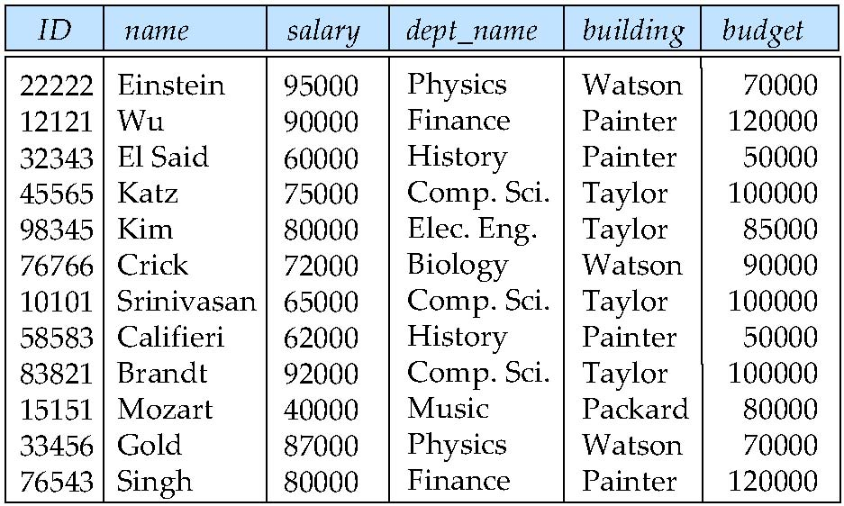
Features of Good Relational Designs
Suppose we combine instructor and department into in_dep, which represents the natural join on the relations instructor and department
There is repetition of information
dept_name ➔ (building, budget)
If I know the dept_name, I can “look up” (building, budget)
Need to use null values (if we add a new department with no instructors)
Assume that a department
Has a single budget.
Is in one building.

Slide 28
The Perils of Redundancy
One obvious issue is duplicate values ➔ Storage overhead/wasted space.
This can still be an issue for very large datasets, but … …
Storage has become so inexpensive that this is less of an issue.
The primary issue is “update anomalies.”
In the schema faculty_dept(ID, name, salary, dept_name, building, budget)
The update UPDATE faculty_dept SET building=“Canary” WHERE ID=‘10101’ would create an anomaly.
10101’s dept_name is ‘Comp. Sci.’ but the building is not ‘Taylor’.
This violates the logical constraint because it implies that the ‘Comp. Sci.’ department is in the buildings ‘Taylor’ and ‘Canary’.
Relying on users and programmers to only perform “correct” updates is risky and error-prone.
I could prevent the problem with a check constraint, but the underlying issue is that the schema is “not good.”
Normalization formalizes what it means for a schema ”to be good.”

Slide 29
Introduction to Normalization
Introduction
29 | COMS W4111_002_2025_1 - Lecture 7: ER(6), Relational(6), SQL(6) © Donald F. Ferguson, 2025

Slide 30
Features of Good Relational Designs
Hypothetically, assume our schema originally had one relation that provided information about faculty and departments.
Suppose we combine instructor and department into in_dep, which represents the natural join on the relations instructor and department
There is repetition of information
Need to use null values (if we add a new department with no instructors)
Instructor(id, name, salary, dept_name)
Department(dept_name, building, budget)
F:dept_name --> {building, budget}

Slide 31
Decomposition
The only way to avoid the repetition-of-information problem in the in_dep schema is to decompose it into two schemas – instructor and department schemas.
Not all decompositions are good. Suppose we decompose
employee(ID, name, street, city, salary)
into
employee1 (ID, name)
employee2 (name, street, city, salary)
The problem arises when we have two employees with the same name
The next slide shows how we lose information -- we cannot reconstruct the original employee relation -- and so, this is a lossy decomposition.

Slide 32
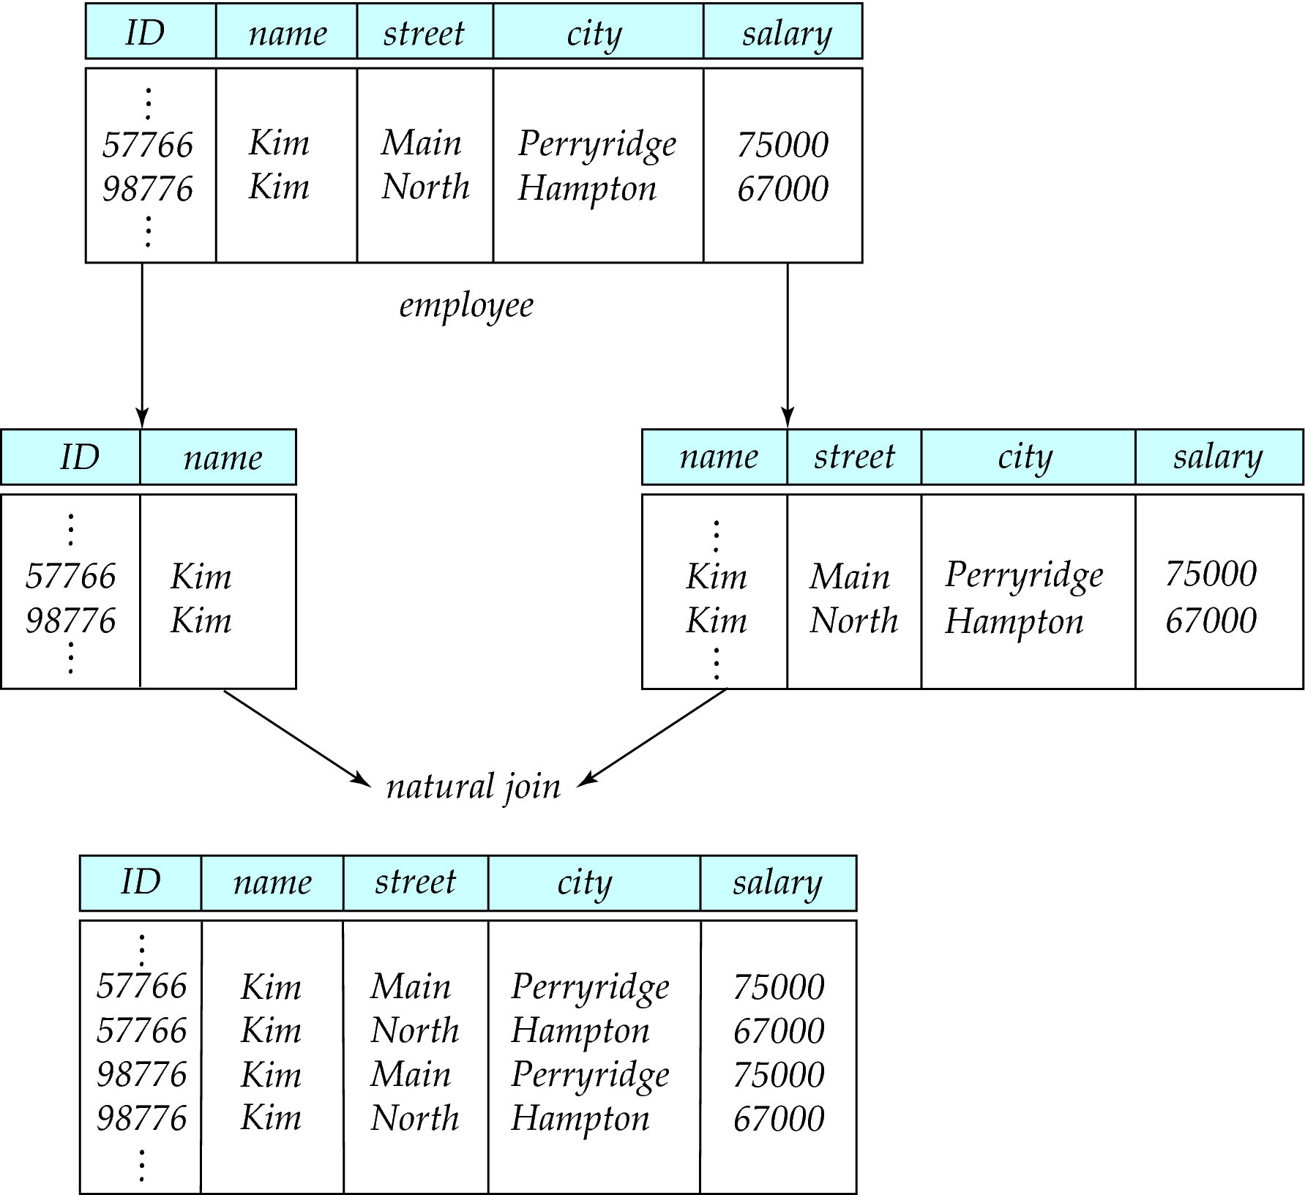
Lossy Decomposition

Slide 33
Normalization Theory
Decide whether a particular relation R is in “good” form.
In the case that a relation R is not in “good” form, decompose it into set of relations {R₁, R₂, ..., R_{n}} such that
Each relation is in good form
The decomposition is a lossless decomposition
Our theory is based on:
Functional dependencies
Multivalued dependencies

Slide 34
Functional Dependencies
There are usually a variety of constraints (rules) on the data in the real world.
For example, some of the constraints that are expected to hold in a university database are:
Students and instructors are uniquely identified by their ID.
Each student and instructor has only one name.
Each instructor and student is (primarily) associated with only one department.
Each department has only one value for its budget, and only one associated building.

Slide 35
Functional Dependencies (Cont.)
An instance of a relation that satisfies all such real-world constraints is called a legal instance of the relation;
A legal instance of a database is one where all the relation instances are legal instances
Constraints on the set of legal relations.
Require that the value for a certain set of attributes determines uniquely the value for another set of attributes.
A functional dependency is a generalization of the notion of a key.

Slide 36
Functional Dependencies Definition
Let R be a relation schema
α ⊆ R and β ⊆ R
The functional dependency
α → β
holds on R if and only if for any legal relations r(R), whenever any two tuples t₁ and t₂ of r agree on the attributes α, they also agree on the attributes β. That is,
t₁[α] = t₂ [α] ⇒ t₁[β ] = t₂ [β ]
Example: Consider r(A,B ) with the following instance of r.
On this instance, B → A hold; A → B does NOT hold,
4
1 5
3 7

Slide 37
Closure of a Set of Functional Dependencies
Given a set F set of functional dependencies, there are certain other functional dependencies that are logically implied by F.
If A → B and B → C, then we can infer that A → C
etc.
The set of all functional dependencies logically implied by F is the closure of F.
We denote the closure of F by F⁺.

Slide 38
Keys and Functional Dependencies
K is a superkey for relation schema R if and only if K → R
K is a candidate key for R if and only if
K → R, and
for no α ⊂ K, α → R
Functional dependencies allow us to express constraints that cannot be expressed using superkeys. Consider the schema:
in_dep (ID, name, salary, dept_name, building, budget ).
We expect these functional dependencies to hold:
dept_name→ building
ID → building
but would not expect the following to hold:
dept_name → salary
DFF Note:
In the current data: ID → dept_name → building
But
In the schema, dept_name may be NULL..

Slide 39
Use of Functional Dependencies
We use functional dependencies to:
To test relations to see if they are legal under a given set of functional dependencies.
If a relation r is legal under a set F of functional dependencies, we say that r satisfies F.
To specify constraints on the set of legal relations
We say that F holds on R if all legal relations on R satisfy the set of functional dependencies F.
Note: A specific instance of a relation schema may satisfy a functional dependency even if the functional dependency does not hold on all legal instances.
For example, a specific instance of instructor may, by chance, satisfy name → ID.

Slide 40
Normal Forms
Introduction
40 | COMS W4111_002_2025_1 - Lecture 7: ER(6), Relational(6), SQL(6) © Donald F. Ferguson, 2025

Slide 41
Boyce-Codd Normal Form
A relation schema R is in BCNF with respect to a set F of functional dependencies if for all functional dependencies in F⁺ of the form
α → β
where α ⊆ R and β ⊆ R, at least one of the following holds:
α → β is trivial (i.e., β ⊆ α)
α is a superkey for R
DFF Note:
The theoretical treatment is not conveying the practical intent.
If α is α superkey, I can set a primary key/unique constraint on α.
Consider tables with address info in the rows.

Slide 42
Decomposing a Schema into BCNF
Let R be a schema R that is not in BCNF. Let α →β be the FD that causes a violation of BCNF.
We decompose R into:
(α U β )
( R - ( β - α ) )
In our example of in_dep,
α = dept_name
β = building, budget
and in_dep is replaced by
(α U β ) = ( dept_name, building, budget )
( R - ( β - α ) ) = ( ID, name, dept_name, salary )
Note:
This is an example only.
Zip code does not imply city or state in real world.
DFF Note – again this is baffling
R = (id, name_last, name_first, street, city, state, zipcode)
α → β means zipcode → (city, state)
(α U β ) = (zipcode, city, state), which we call Address
R - ( β - α ) ). = R - β + α = (id, name_last, name_first, zipcode), which we call Person
Setting primary key ID in Address and zipcode on Address preserves the dependency and is lossless.

Slide 43
BCNF and Dependency Preservation
It is not always possible to achieve both BCNF and dependency preservation
Consider a schema:
dept_advisor(s_ID, i_ID, department_name)
With function dependencies:
i_ID → dept_name
s_ID, dept_name → i_ID
dept_advisor is not in BCNF
i_ID is not a superkey.
Any decomposition of dept_advisor will not include all the attributes in
s_ID, dept_name → i_ID
Thus, the composition is NOT be dependency preserving

Slide 44
Third Normal Form
A relation schema R is in third normal form (3NF) if for all:
α → β in F⁺
at least one of the following holds:
α → β is trivial (i.e., β ∈ α)
α is a superkey for R
Each attribute A in β – α is contained in a candidate key for R.
(NOTE: each attribute may be in a different candidate key)
If a relation is in BCNF it is in 3NF (since in BCNF one of the first two conditions above must hold).
Third condition is a minimal relaxation of BCNF to ensure dependency preservation (will see why later).

Slide 45
3NF Example
Consider a schema:
dept_advisor(s_ID, i_ID, dept_name)
With function dependencies:
i_ID → dept_name
s_ID, dept_name → i_ID
Two candidate keys = {s_ID, dept_name}, {s_ID, i_ID }
We have seen before that dept_advisor is not in BCNF
R, however, is in 3NF
s_ID, dept_name is a superkey
i_ID → dept_name and i_ID is NOT a superkey, but:
{ dept_name} – {i_ID } = {dept_name } and
dept_name is contained in a candidate key

Slide 46
Comparison of BCNF and 3NF
Advantages to 3NF over BCNF. It is always possible to obtain a 3NF design without sacrificing losslessness or dependency preservation.
Disadvantages to 3NF.
We may have to use null values to represent some of the possible meaningful relationships among data items.
There is the problem of repetition of information.

Slide 47

Normalization Simplified
47 | W4111-2024F-11-HW3b4b-Normalization-ModuleIV © Donald F. Ferguson, 2024

Slide 48
Ferguson’s Laws of Teaching Databases
First Law: “There is no database concept so simple that database textbooks and course material cannot make the concept baffling and incomprehensible.”
Second Law: “No matter how baffling and incomprehensible a textbook or course material has made a simple concept, the course material will enhance the bewilderment by using unintelligible, confusing notation and quasi-math.”
My girlfriend saw this slide and added a 3rd Law.
Third Law: “The grumpy professor will inevitably make the concept terrifying in addition to baffling and incomprehensible.”

Slide 49
Goals of Normalization
Let R be a relation scheme with a set F of functional dependencies.
Decide whether a relation scheme R is in “good” form.
In the case that a relation scheme R is not in “good” form, need to decompose it into a set of relation scheme {R₁, R₂, ..., R_{n}} such that:
Each relation scheme is in good form
The decomposition is a lossless decomposition
Preferably, the decomposition should be dependency preserving.
DFF says, in a nutshell,
There are a few simple patterns to look for and fix.
Use common sense.

Slide 50
Denormalization for Performance
May want to use non-normalized schema for performance
For example, displaying prereqs along with course_id, and title requires join of course with prereq
Alternative 1: Use denormalized relation containing attributes of course as well as prereq with all above attributes
faster lookup
extra space and extra execution time for updates
extra coding work for programmer and possibility of error in extra code
Alternative 2: use a materialized view defined a course prereq
Benefits and drawbacks same as above, except no extra coding work for programmer and avoids possible errors

Slide 51
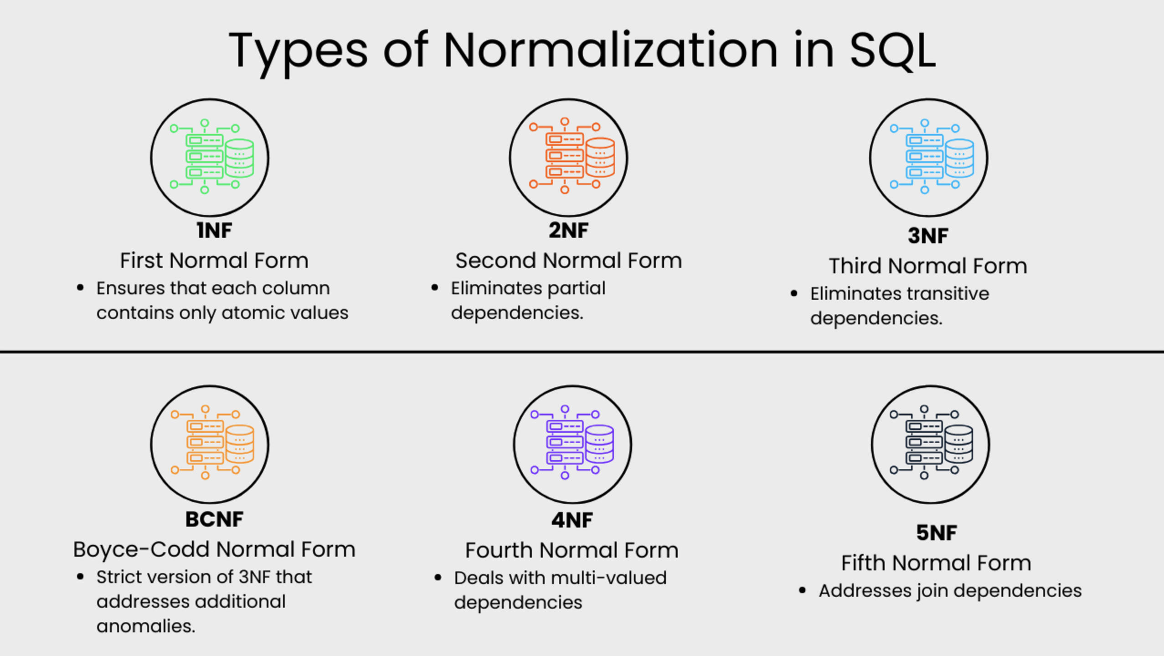
Simple Explanations
There are many good examples and tutorials on the web, e.g. https://www.datacamp.com/tutorial/normalization-in-sql

Slide 52
Simple Explanations
There are a lot of good, simple, short explanations and tutorials on the web.
First Normal Form (1NF)
This normalization level ensures that each column in your data contains only atomic values. Atomic values in this context means that each entry in a column is indivisible. It is like saying that each cell in a spreadsheet should hold just one piece of information. 1NF ensures atomicity of data, with each column cell containing only a single value and each column having unique names.
Second Normal Form (2NF)
Eliminates partial dependencies by ensuring that non-key attributes depend only on the primary key. What this means, in essence, is that there should be a direct relationship between each column and the primary key, and not between other columns.
Third Normal Form (3NF)
Removes transitive dependencies by ensuring that non-key attributes depend only on the primary key. This level of normalization builds on 2NF.
Boyce-Codd Normal Form (BCNF)
This is a more strict version of 3NF that addresses additional anomalies. At this normalization level, every determinant is a candidate key.
Fourth Normal Form (4NF)
This is a normalization level that builds on BCNF by dealing with multi-valued dependencies.
Fifth Normal Form (5NF)
5NF is the highest normalization level that addresses join dependencies. It is used in specific scenarios to further minimize redundancy by breaking a table into smaller tables.

Slide 53
Wide-Flat versus Normalization
53 | W4111-2024F-11-HW3b4b-Normalization-ModuleIV © Donald F. Ferguson, 2024

Slide 54
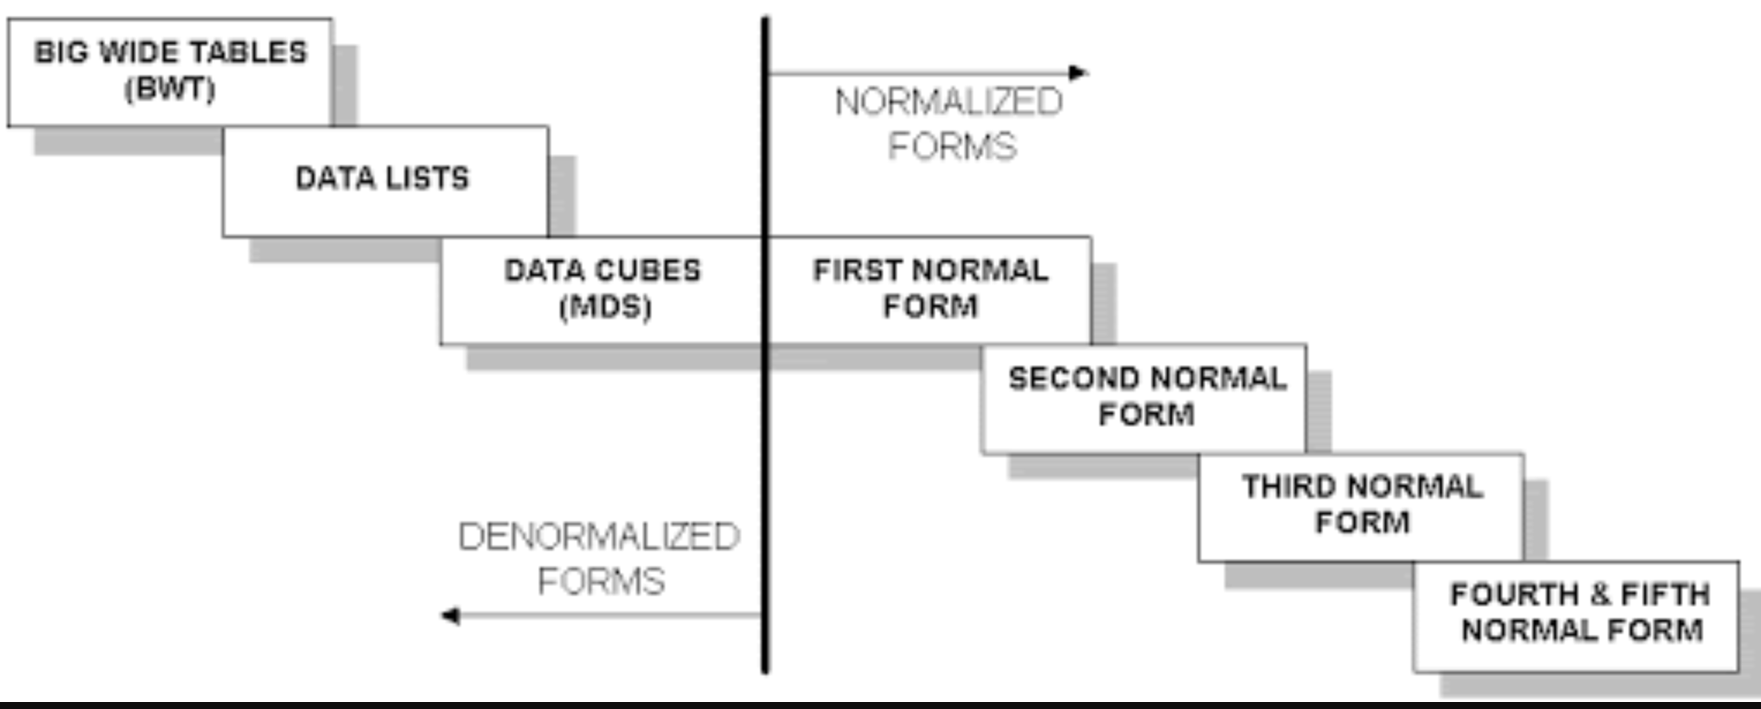
Wide Flat Tables
Good for Integrity
Good for Query
Improve query performance by precomputing and saving:
JOINs
Aggregation
Derived/computed columns
One of the primary strength of the relational model is maintaining “integrity” when applications create, update and delete data. This relies on:
The core capabilities of the relational model, e.g. constraints.
A well-design database (We will cover a formal definition – “normalization” in more detail later.
Data models that are well designed for integrity are very bad for read only analysis queries. We will build and analyze wide flat tables as part of the analysis tasks in HW3, HW4 as projects.

Slide 55
NoSQL
55 | COMS W4111_002_2025_1 - Lecture 7: ER(6), Relational(6), SQL(6) © Donald F. Ferguson, 2025

Slide 56
Overview (I) (https://en.wikipedia.org/wiki/NoSQL)
A NoSQL (originally referring to "non SQL" or "non relational")^{[1]} database provides a mechanism for storage and retrieval of data that is modeled in means other than the tabular relations used in relational databases. Such databases have existed since the late 1960s, but did not obtain the "NoSQL" moniker until a surge of popularity in the early twenty-first century,^{[2]} triggered by the needs of Web 2.0 companies such as Facebook, Google, and Amazon.com.^{[3][4][5]} NoSQL databases are increasingly used in big data and real-time web applications.^{[6]} NoSQL systems are also sometimes called "Not only SQL" to emphasize that they may support SQL-like query languages.^{[7][8]}
Motivations for this approach include: simplicity of design, simpler "horizontal" scaling to clusters of machines (which is a problem for relational databases),^{[2]} and finer control over availability. The data structures used by NoSQL databases (e.g. key-value, wide column, graph, or document) are different from those used by default in relational databases, making some operations faster in NoSQL. The particular suitability of a given NoSQL database depends on the problem it must solve. Sometimes the data structures used by NoSQL databases are also viewed as "more flexible" than relational database tables.^{[9]}

Slide 57
Overview (I) (https://en.wikipedia.org/wiki/NoSQL)
Many NoSQL stores compromise consistency (in the sense of the CAP theorem) in favor of availability, partition tolerance, and speed. Barriers to the greater adoption of NoSQL stores include the use of low-level query languages (instead of SQL, for instance the lack of ability to perform ad-hoc joins across tables), lack of standardized interfaces, and huge previous investments in existing relational databases.^{[10]} Most NoSQL stores lack true ACID transactions, … …
Instead, most NoSQL databases offer a concept of "eventual consistency" in which database changes are propagated to all nodes "eventually" (typically within milliseconds) so queries for data might not return updated data immediately or might result in reading data that is not accurate, a problem known as stale reads.^{[11]} Additionally, some NoSQL systems may exhibit lost writes and other forms of data loss.^{[12]} Fortunately, some NoSQL systems provide concepts such as write-ahead logging to avoid data loss.^{[13]} For distributed transaction processing across multiple databases, data consistency is an even bigger challenge that is difficult for both NoSQL and relational databases. Even current relational databases "do not allow referential integrity constraints to span databases."^{[14]}

Slide 58
Simplistic Classification (https://medium.com/swlh/4-types-of-nosql-databases-d88ad21f7d3b)
Relational is the foundational model.
We will see OLAP in a future lecture.
Subject of this lecture and part of HW3
We covered graphs and examples.

Slide 59
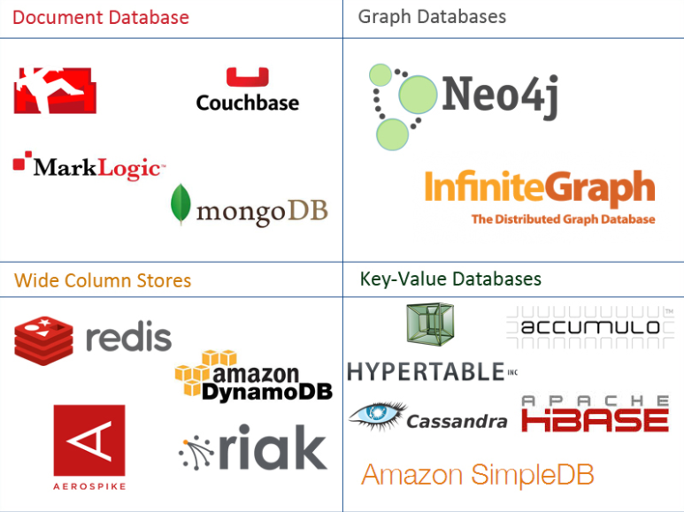
One Taxonomy

Slide 60
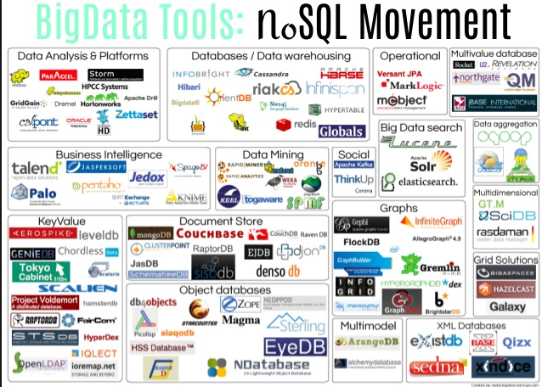
Another Taxonomy

Slide 61
Use Cases
Motivations
Massive write performance.
Fast key value look ups.
Flexible schema and data types.
No single point of failure.
Fast prototyping and development.
Out of the box scalability.
Easy maintenance.
What is wrong with SQL/Relational?
Nothing. One size fits all? Not really.
Impedance mismatch. – Object Relational Mapping doesn’t work quite well.
Rigid schema design.
Harder to scale.
Replication.
Joins across multiple nodes? Hard.
How does RDMS handle data growth? Hard.
Need for a DBA.
Many programmers are already familiar with it.
Transactions and ACID make development easy.
Lots of tools to use.

Slide 62
Applications
62 | COMS W4111_002_2025_1 - Lecture 7: ER(6), Relational(6), SQL(6) © Donald F. Ferguson, 2025

Slide 63
Concepts
63 | COMS W4111_002_2025_1 - Lecture 7: ER(6), Relational(6), SQL(6) © Donald F. Ferguson, 2025

Slide 64
Database Applications
There are many, many types of database applications.
Two common categories are
Operational/Interactive:
Users and roles can create, retrieve, update, search and delete “records.”
Examples: SSOL, ATMs, … …
Web applications are one of the more common types of operational application.
Business Intelligence, Decision Support, …:
Users can perform complex queries and analyze a lot of data to generate a report, make decisions, … …
Data science and AI are the fun parts; Data Engineering is the hard part.
Examples: Build AI/ML training data, dashboards, … …
The remaining HW assignments:
Programming track will implement a simple web application.
Non-programming track will implement data engineering.

Slide 65
Overall System

Slide 66
Web Applications
66 | COMS W4111_002_2025_1 - Lecture 7: ER(6), Relational(6), SQL(6) © Donald F. Ferguson, 2025

Slide 67
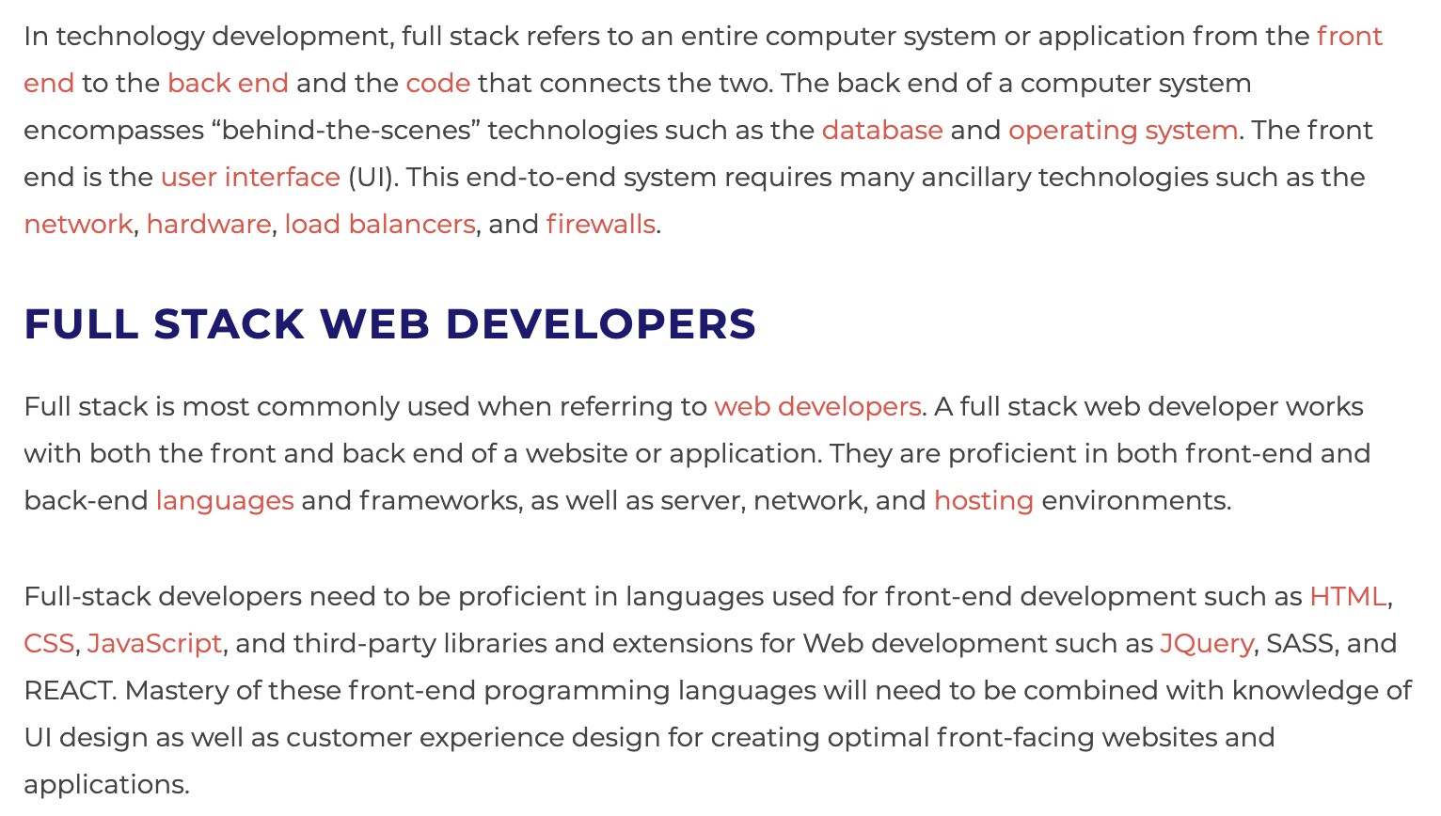
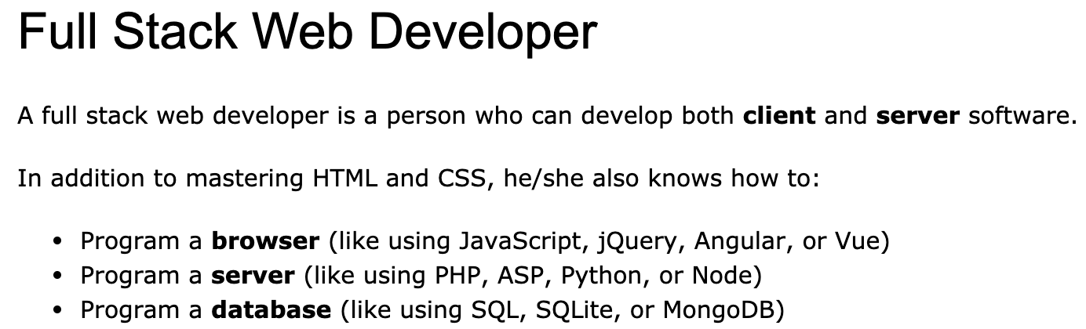
Full Stack Application
https://www.w3schools.com/whatis/whatis_fullstack.asp
There are courses that cover topics:
COMS W4153: Advanced Software Engineering
COMS W4111: Introduction to Databases
COMS W4170 - User Interface Design
This course will focus on cloud realization, microservices and application patterns, ... ...
Also, I am not great at UIs ... ... We will not emphasize or require a lot of UI work.
https://www.webopedia.com/definitions/full-stack/

Slide 68
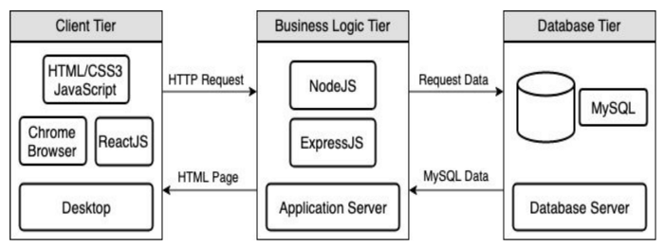
Full Stack Web Application
M = Mongo
E = Express
R = React
N = Node
I start with FastAPI and MySQL, but all the concepts are the same.
https://levelup.gitconnected.com/a-complete-guide-build-a-scalable-3-tier-architecture-with-mern-stack-es6-ca129d7df805
My preferences are to replace React with Angular, and Node with Flask.
There are three projects to design, develop, test, deploy, ... ...
Browser UI application.
Microservice.
Database.
We will initial have two deployments: local machine, virtual machine. We will ignore the database for step 1.

Slide 69
Some Terms
A web application server or web application framework: “A web framework (WF) or web application framework (WAF) is a software framework that is designed to support the development of web applications including web services, web resources, and web APIs. Web frameworks provide a standard way to build and deploy web applications on the World Wide Web. Web frameworks aim to automate the overhead associated with common activities performed in web development. For example, many web frameworks provide libraries for database access, templating frameworks, and session management, and they often promote code reuse.” (https://en.wikipedia.org/wiki/Web_framework)
REST: “REST (Representational State Transfer) is a software architectural style that was created to guide the design and development of the architecture for the World Wide Web. REST defines a set of constraints for how the architecture of a distributed, Internet-scale hypermedia system, such as the Web, should behave. The REST architectural style emphasises uniform interfaces, independent deployment of components, the scalability of interactions between them, and creating a layered architecture to promote caching to reduce user-perceived latency, enforce security, and encapsulate legacy systems.[1] REST has been employed throughout the software industry to create stateless, reliable web-based applications.” (https://en.wikipedia.org/wiki/REST)

Slide 70
Some Terms
OpenAPI: “The OpenAPI Specification, previously known as the Swagger Specification, is a specification for a machine-readable interface definition language for describing, producing, consuming and visualizing web services.” (https://en.wikipedia.org/wiki/OpenAPI_Specification)
Model: “A model represents an entity of our application domain with an associated type.” (https://medium.com/@nicola88/your-first-openapi-document-part-ii-data-model-52ee1d6503e0)
Routers: “What fastapi docs says about routers: If you are building an application or a web API, it’s rarely the case that you can put everything on a single file. FastAPI provides a convenience tool to structure your application while keeping all the flexibility.” (https://medium.com/@rushikeshnaik779/routers-in-fastapi-tutorial-2-adf3e505fdca)
Summary:
These are general concepts, and we will go into more detail in the semester.
FastAPI is a specific technology for Python.
There are many other frameworks applicable to Python, NodeJS/TypeScript, Go, C#, Java, … …
They all surface similar concepts with slightly different names.

Slide 71
REST (https://restfulapi.net/)
What is REST
REST is acronym for REpresentational State Transfer. It is architectural style for distributed hypermedia systems and was first presented by Roy Fielding in 2000 in his famous dissertation.
Like any other architectural style, REST also does have it’s own 6 guiding constraints which must be satisfied if an interface needs to be referred as RESTful. These principles are listed below.
Guiding Principles of REST
Client–server – By separating the user interface concerns from the data storage concerns, we improve the portability of the user interface across multiple platforms and improve scalability by simplifying the server components.
Stateless – Each request from client to server must contain all of the information necessary to understand the request, and cannot take advantage of any stored context on the server. Session state is therefore kept entirely on the client.
Cacheable – Cache constraints require that the data within a response to a request be implicitly or explicitly labeled as cacheable or non-cacheable. If a response is cacheable, then a client cache is given the right to reuse that response data for later, equivalent requests.
Uniform interface – By applying the software engineering principle of generality to the component interface, the overall system architecture is simplified and the visibility of interactions is improved. In order to obtain a uniform interface, multiple architectural constraints are needed to guide the behavior of components. REST is defined by four interface constraints: identification of resources; manipulation of resources through representations; self-descriptive messages; and, hypermedia as the engine of application state.
Layered system – The layered system style allows an architecture to be composed of hierarchical layers by constraining component behavior such that each component cannot “see” beyond the immediate layer with which they are interacting.
Code on demand (optional) – REST allows client functionality to be extended by downloading and executing code in the form of applets or scripts. This simplifies clients by reducing the number of features required to be pre-implemented.

Slide 72
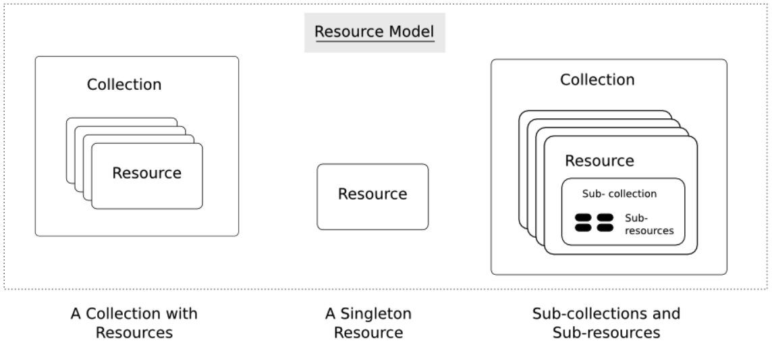
Resources
Resources are an abstraction. The application maps to create things and actions.
“A resource-oriented API is generally modeled as a resource hierarchy, where each node is either a simple resource or a collection resource. For convenience, they are often called a resource and a collection, respectively.
A collection contains a list of resources of the same type. For example, a user has a collection of contacts.
A resource has some state and zero or more sub-resources. Each sub-resource can be either a simple resource or a collection resource.
For example, Gmail API has a collection of users, each user has a collection of messages, a collection of threads, a collection of labels, a profile resource, and several setting resources.
While there is some conceptual alignment between storage systems and REST APIs, a service with a resource-oriented API is not necessarily a database, and has enormous flexibility in how it interprets resources and methods. For example, creating a calendar event (resource) may create additional events for attendees, send email invitations to attendees, reserve conference rooms, and update video conference schedules. (Emphasis added) (https://cloud.google.com/apis/design/resources#resources)
https://restful-api-design.readthedocs.io/en/latest/resources.html

Slide 73
REST – Resource Oriented
When writing applications, we are used to writing functions or methods:
openAccount(last_name, first_name, tax_payer_id)
account.deposit(deposit_amount)
account.close()
We can create and implement whatever functions we need.
REST only allows four methods:
POST: Create a resource
GET: Retrieve a resource
PUT: Update a resource
DELETE: Delete a resource
That’s it. That’s all you get.
A REST client needs no prior knowledge about how to interact with any particular application or server beyond a generic understanding of hypermedia.
“The key characteristic of a resource-oriented API is that it emphasizes resources (data model) over the methods performed on the resources (functionality). A typical resource-oriented API exposes a large number of resources with a small number of methods.” (https://cloud.google.com/apis/design/resources)

Slide 74
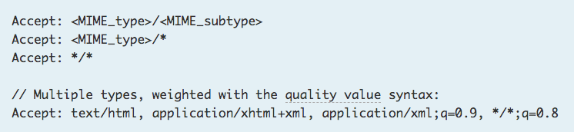
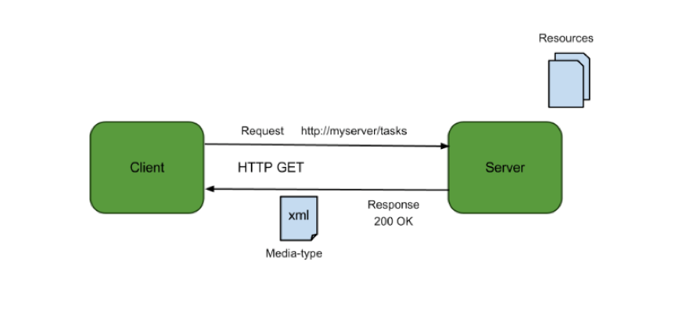
Resources, URLs, Content Types
Relative URL identifies “resource” on the server.
Server implementation maps abstract resource to tangible “thing,” file, DB row, … and any application logic.
Accept type in headers.
Client may be
Browser
Mobile device
Other REST Service
… …
Web media (content) type, e.g.
text/html
application/json

Slide 75
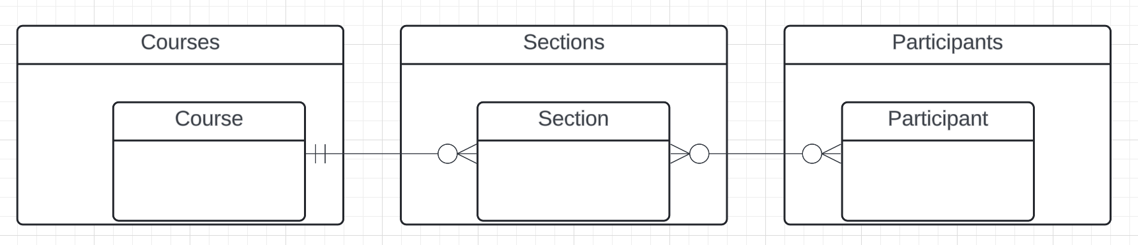
Resources and APIs
Base resources, paths and methods:
/courses: GET, POST
/courses/<id>: GET, PUT, DELETE
/sections: GET, POST
/sections/<id>: GET, PUT, DELETE
/participants: GET, POST
/participants/<id>: GET, PUT, DELETE
There are relative, navigation paths:
/courses/<id>/sections
/participants/<id>/sections
etc.
GET on resources that are collections may also have query parameters.
There are two approaches to defining API
Start with OpenAPI document and produce an implementation template.
Start with annotated code and generate API document.
In either approach, I start with models.
Also,
I lack the security permission to update CourseWorks.
I can choose to not surface the methods or raise and exception.

Slide 76
Data Modeling Concepts and REST
Almost any data model has the same core concepts:
Types and instances:
Entity Type: A definition of a type of thing with properties and relationships.
Entity Instance: A specific instantiation of the Entity Type
Entity Set Instance: An Entity Type that:
Has properties and relationships like any entity, but ...
Has at least one special relationship – contains.
Operations, minimally CRUD, that manipulate entity types and instances:
Create
Retrieve
Update
Delete
Reference/Identify/... ...
Host/database/table/pk

Slide 77
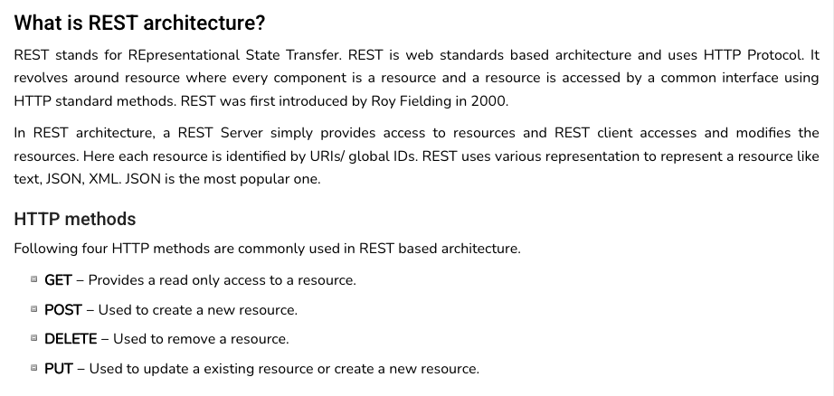
REST (https://www.tutorialspoint.com/restful/restful_introduction.htm)

Slide 78
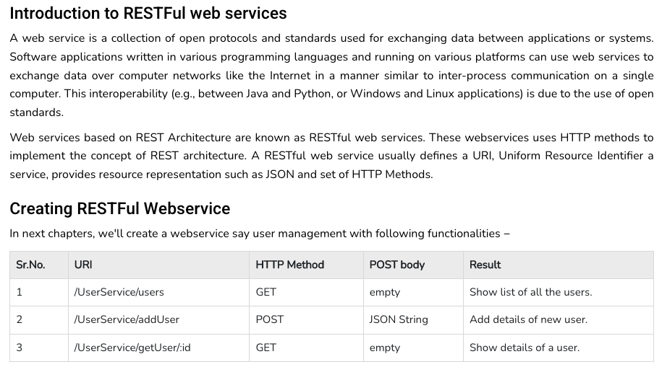
REST (https://www.tutorialspoint.com/restful/restful_introduction.htm)

Slide 79
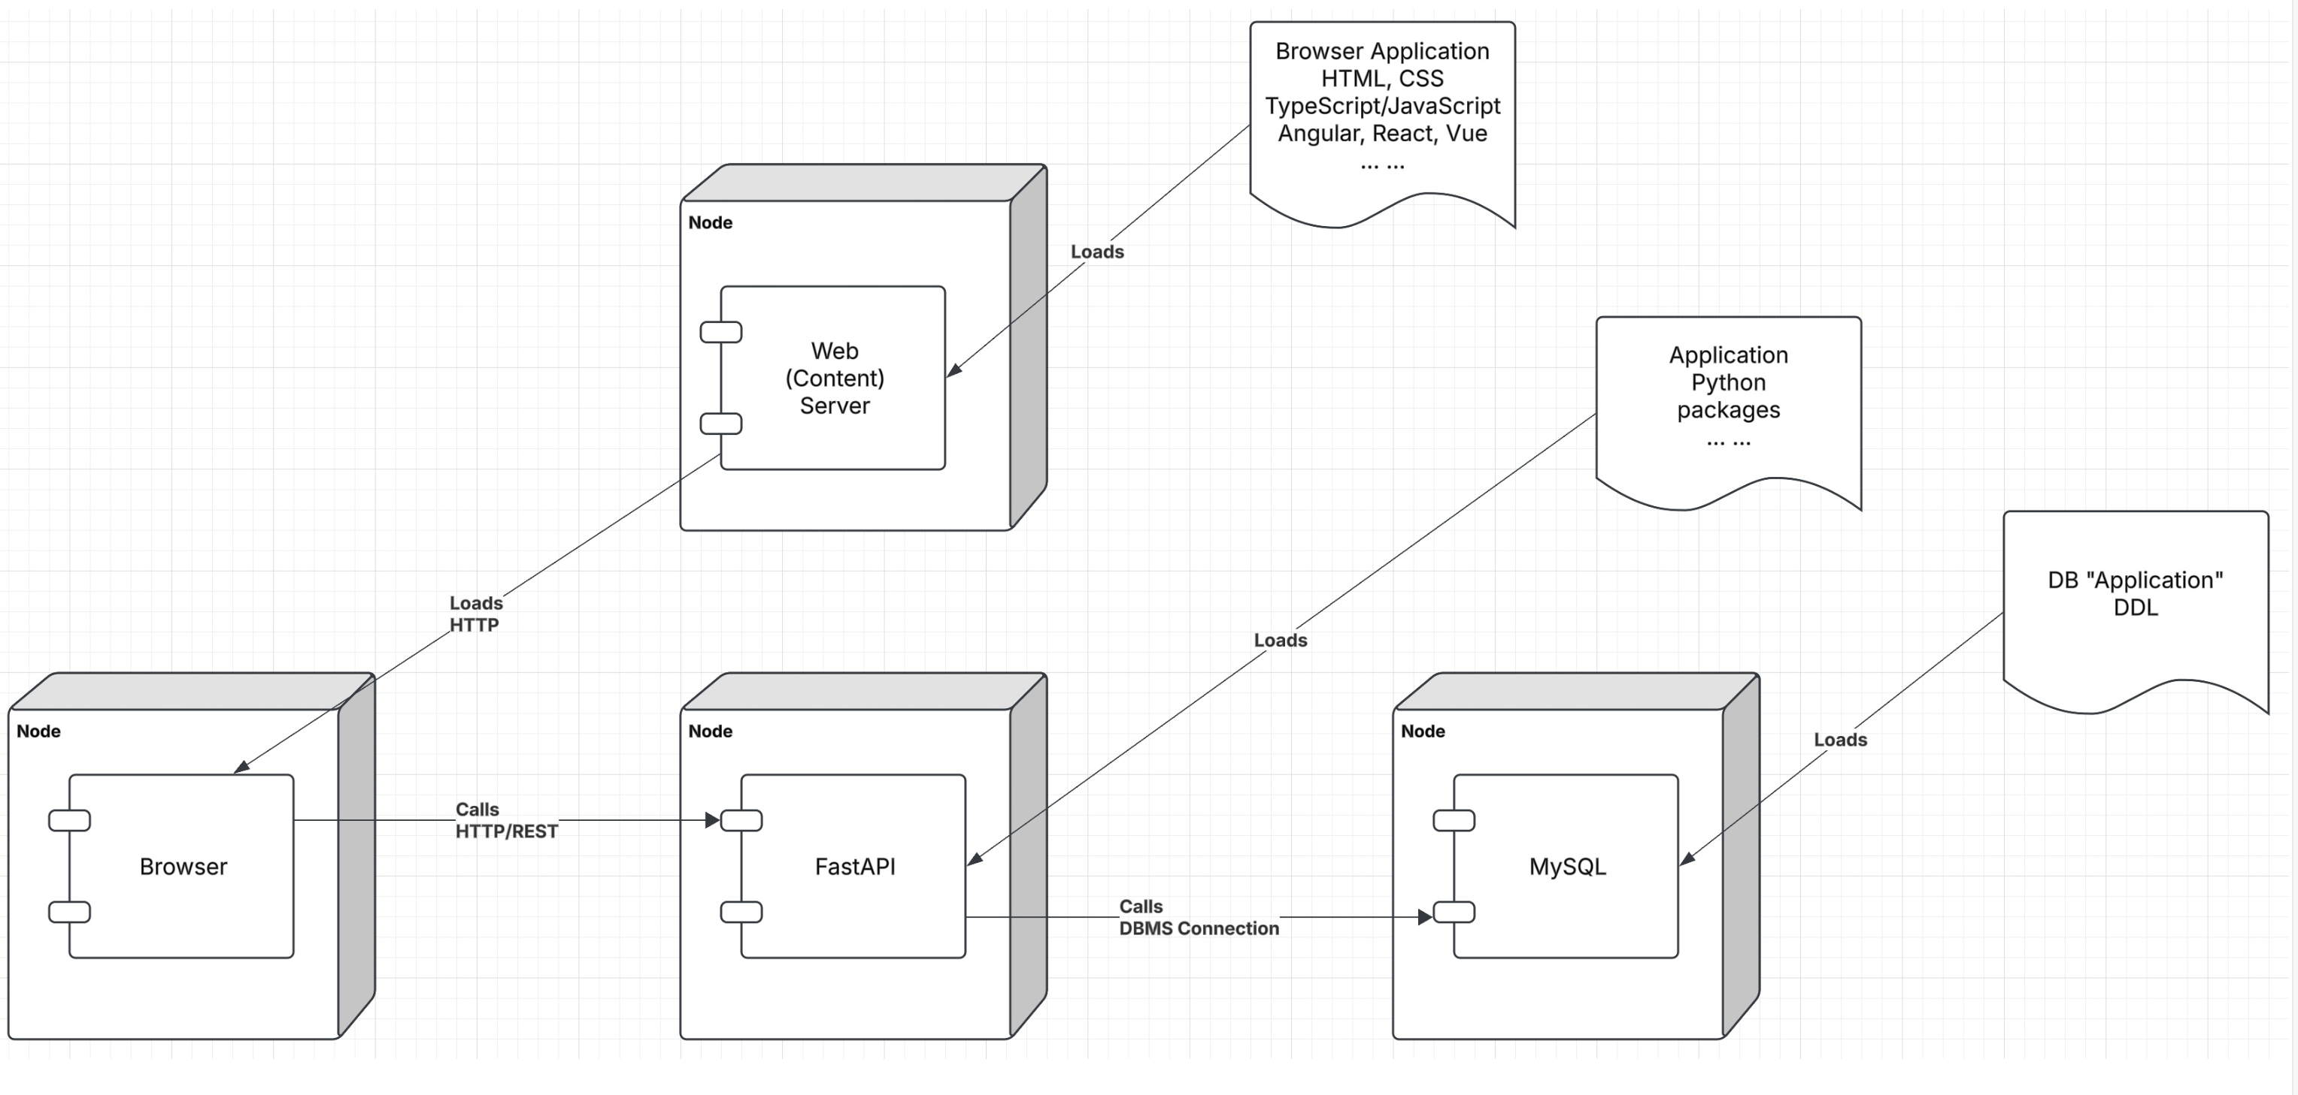
Let’s Look at the Programming Project

Slide 80
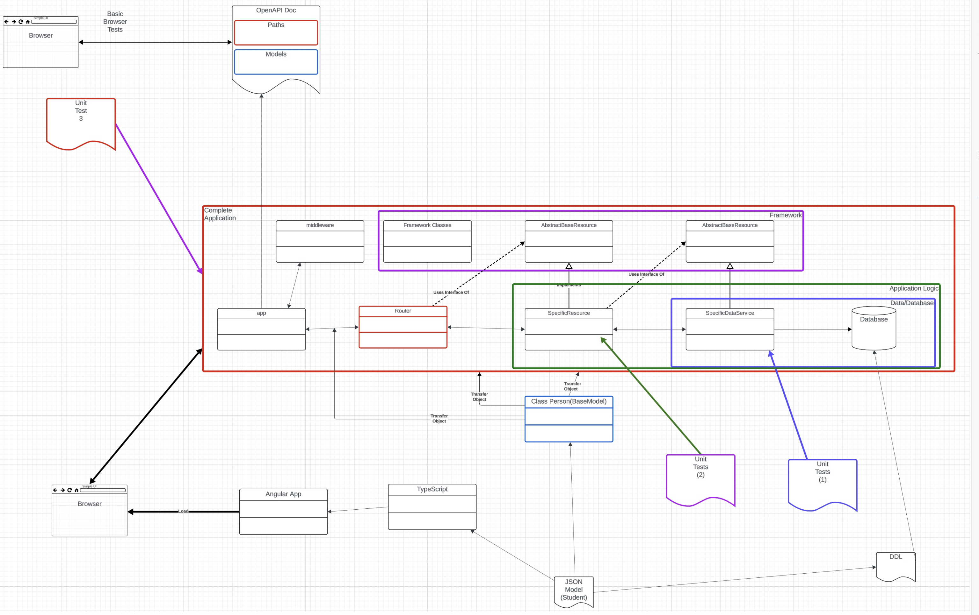
Let’s Look at the Programming Project

Slide 81
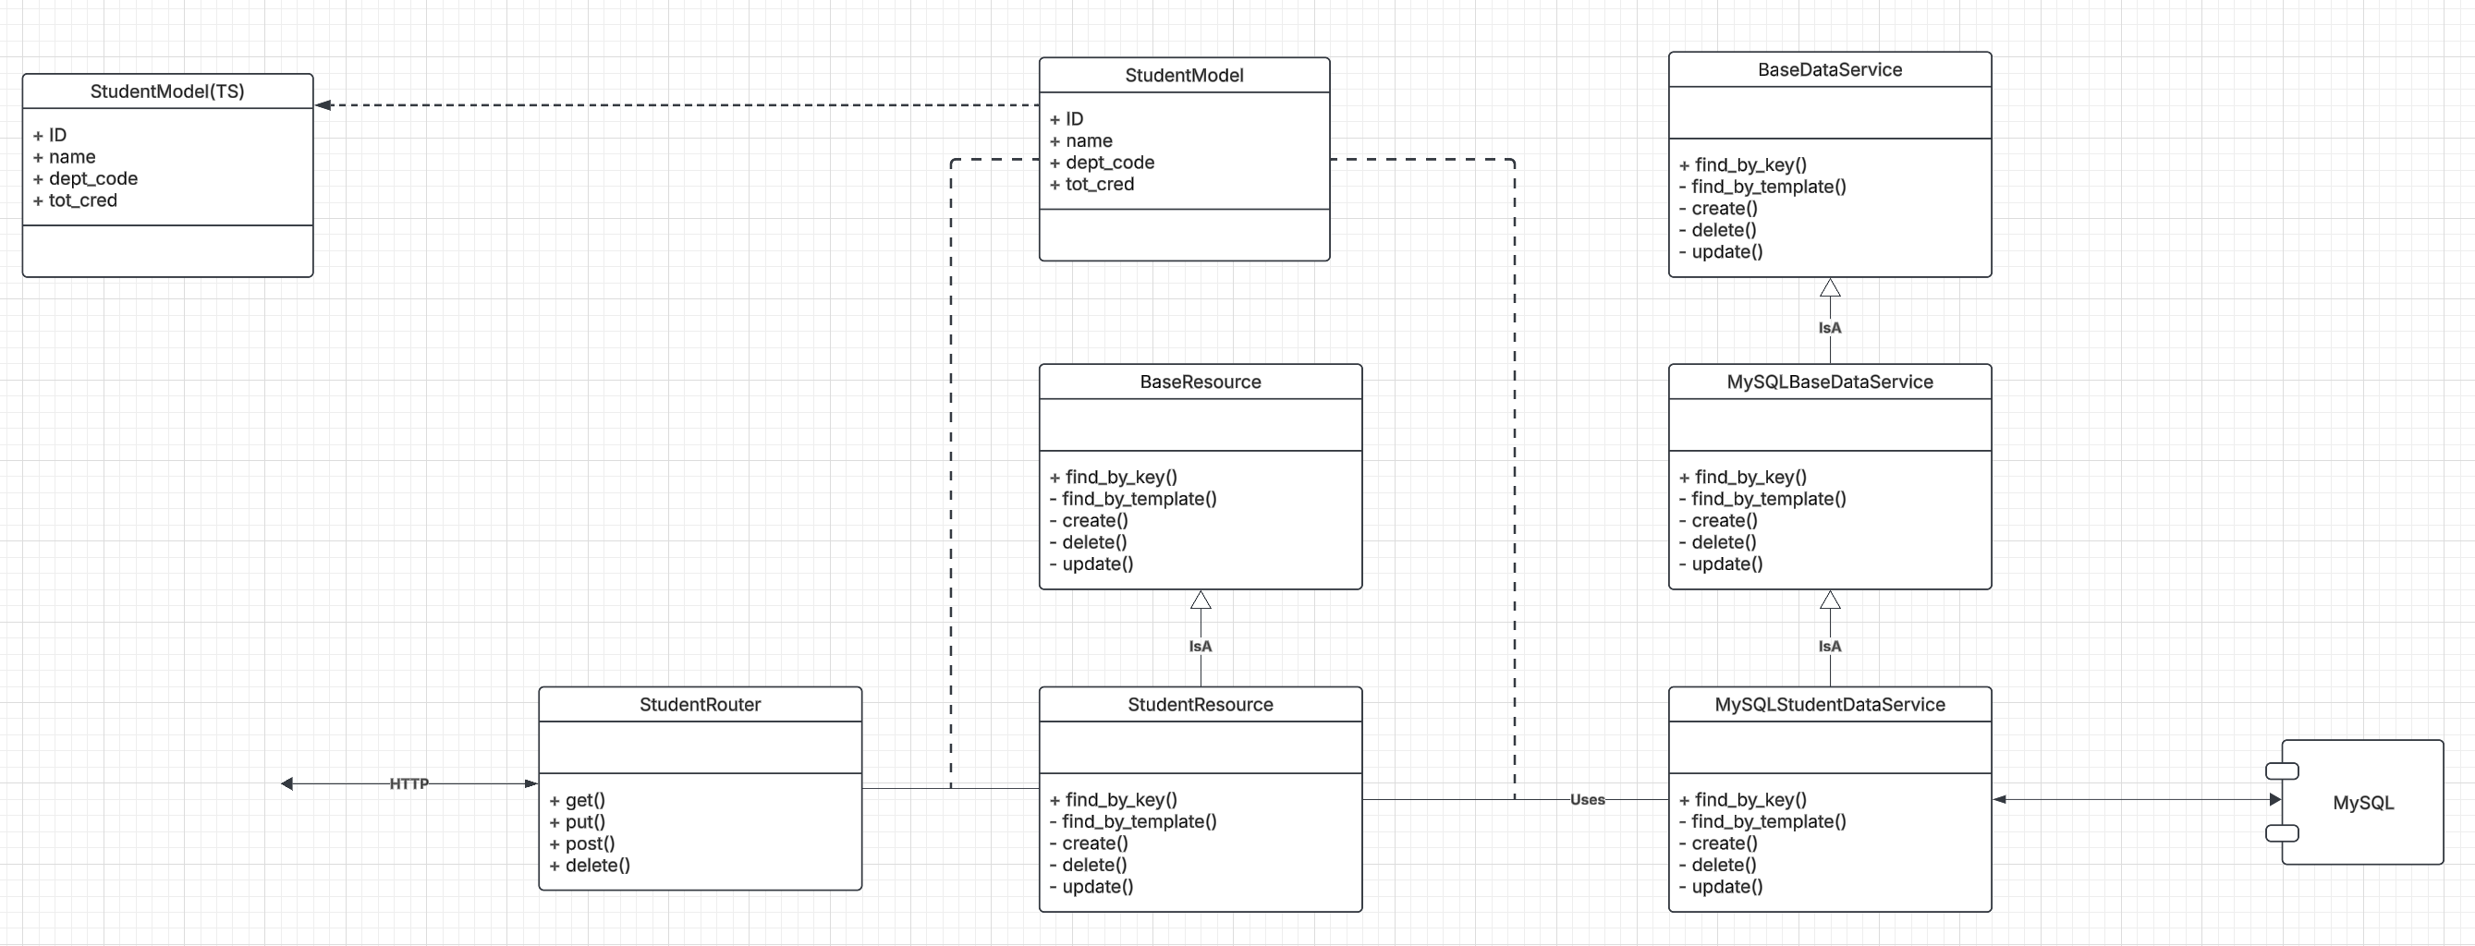
Let’s Look at the Programming Project

Slide 82
A Simple Example
Let’s assume that we wanted to extend the template to surface
db_book.instructor and db_book.department
As resources.
This would result in two resources instructor and department.
The first steps are:
Create models for instructor and department.
Create DepartmentMySQLDataService and InstructorMySQLDataService.
Unit test, using the functionality of the base class.
Make DepartmentResource and InstructorResource by copying and modifying StudentResource.
Follow the pattern in service_factory.py to set up the services and resources.
Copy and modify interactive_app/ts/t_artist_resource.py and unit test.
Modify main.py to have the necessary imports.
Add the paths for /instructor, /department, /instructor/{ID}, /department/{dept_name}
Execute
Go to docs to test.

Slide 83
Data Engineering
83 | COMS W4111_002_2025_1 - Lecture 7: ER(6), Relational(6), SQL(6) © Donald F. Ferguson, 2025

Slide 84
Data Warehouse and Data Lake

Slide 85
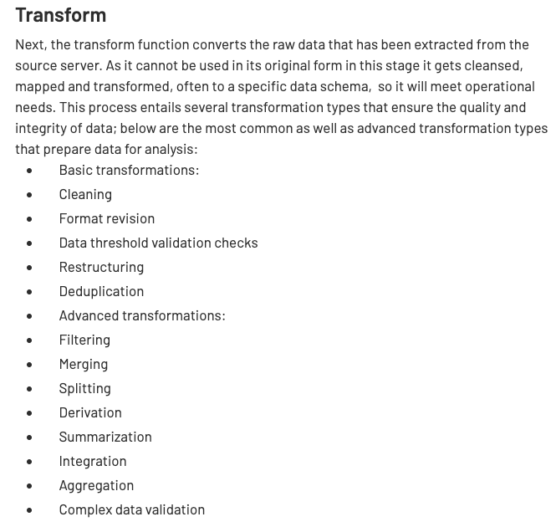
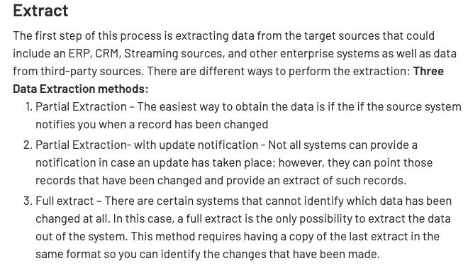
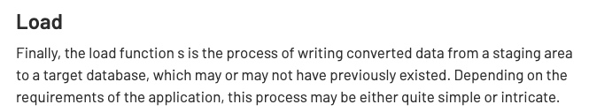
ETL Concepts
https://databricks.com/glossary/extract-transform-load

Slide 86
Data Engineering Overview
We will spend 1.5 to 2 lectures in Module IV on “Big Data,” and this will cover data engineering. ➔ We are not going to spend time explaining it now.
The core concepts are
Extract – Transform – Load aka Extract – Load – Transform
Data Warehouse, Data Lake
Directed Acyclic Data Flow Graphs
Algebraic Transformation Operators
We are going to keep this simple for now:
MySQL will be the data warehouse.
We will use Jupyter notebooks and SQL for ETL.
Go to data engineering example in project template.

Slide 87
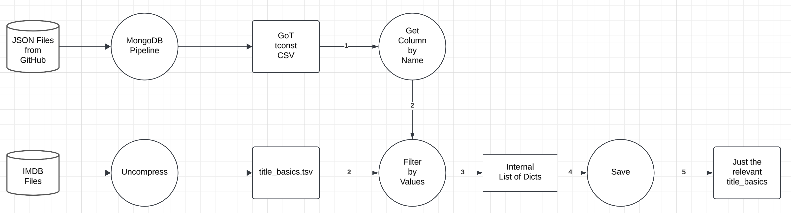
Simple DAG
Subset of the logical DAG for data engineering.
Data sources to extract:
IMDB: https://developer.imdb.com/non-commercial-datasets/
Game of Thrones: https://github.com/jeffreylancaster/game-of-thrones
Sample implementation in project template: common_data_engineering/Data_Engineering_Phase_1_Example.ipynb

